Slide 1
Approaches to AI

Slide 2
Turing Test
Turing Test was introduced by Turing in his 1950 paper, "Computing Machinery and Intelligence," which considered the question, "Can Machine think?"
Alan Turing introduced a test to check whether a machine can think like a human or not, this test is known as the Turing Test.
In this test, Turing proposed that the computer can be said to be an intelligent if it can mimic human response under specific conditions.
So, The success of an intelligent behavior of a system can be measured with Turing Test.

Slide 3
Turing Test
Two persons and a machine to be evaluated participate in the test.
Out of the two persons, one plays the role of the tester.
Each of them sits in different rooms.
The tester is unaware of who is machine and who is a human.
He/She interrogates the questions by typing and sending them to both intelligences, to which he receives typed responses.
This test aims at fooling the tester.
If the tester fails to determine machine’s response from the human response, then the machine is said to be intelligent.

Slide 4
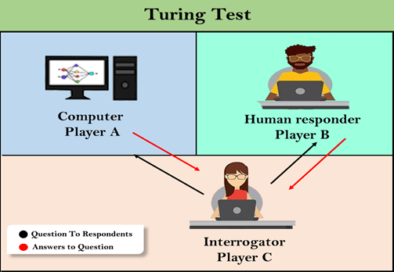

Slide 5
Turing Test
The test result does not depend on each correct answer, but only how closely its responses like a human answer.
The computer is permitted to do everything possible to force a wrong identification by the interrogator.
The questions and answers can be like:
Interrogator: Are you a computer?
Player A (Computer): No
Interrogator: Multiply two large numbers such as (256896489*456725896)
Player A: Long pause and give the wrong answer.

Slide 6
Turing Test
In this game, if an interrogator would not be able to identify which is a machine and which is human, then the computer passes the test successfully, and the machine is said to be intelligent and can think like a human.

Slide 7
Competition for Turing Test
"In 1991, the New York businessman Hugh Loebner announced the prize competition, offering a $100,000 prize for the first computer to pass the Turing test.
However, no AI program to till date, come close to passing an undiluted Turing test".

Slide 8
Chatbots to attempt the Turing test
ELIZA
ELIZA was a Natural language processing computer program created by Joseph Weizenbaum.
It was created to demonstrate the ability of communication between machine and humans.
It was one of the first chatterbots, which has attempted the Turing Test.
Parry
Parry was a chatterbot created by Kenneth Colby in 1972.
Parry was designed to simulate a person with Paranoid schizophrenia(most common chronic mental disorder).
Parry was described as "ELIZA with attitude."
Parry was tested using a variation of the Turing Test in the early 1970s.

Slide 9
Chatbots to attempt the Turing test
Eugene Goostman
Eugene Goostman was a chatbot developed in Saint Petersburg in 2001.
This bot has competed in the various number of Turing Test.
In June 2012, at an event, Goostman won the competition promoted as largest-ever Turing test contestant, in which it has convinced 29% of judges that it was a human.
Goostman resembled as a 13-year old virtual boy.

Slide 10
The Chinese Room Argument
There were many philosophers who really disagreed with the complete concept of Artificial Intelligence.
The most famous argument in this list was "Chinese Room."

Slide 11
The Chinese Room Argument
In the year 1980, John Searle presented "Chinese Room" thought experiment, in his paper "Mind, Brains, and Program," which was against the validity of Turing's Test.
According to his argument, "Programming a computer may make it to understand a language, but it will not produce a real understanding of language or consciousness in a computer."
He argued that Machine such as ELIZA and Parry could easily pass the Turing test by manipulating keywords and symbol, but they had no real understanding of language.
So it cannot be described as "thinking" capability of a machine such as a human.

Slide 12
Features required for a machine to pass the Turing test
Natural language processing
NLP is required to communicate with Interrogator in general human language like English.
Knowledge representation
To store and retrieve information during the test.
Automated reasoning
To use the previously stored information for answering the questions.
Machine learning
To adapt new changes and can detect generalized patterns.
Vision (For total Turing test)
To recognize the interrogator actions and other objects during a test.
Motor Control (For total Turing test)
To act upon objects if requested.

Slide 13
AI System
An AI system is composed of an agent and its environment.
The agents act in their environment.
The environment may contain other agents.

Slide 14
Intelligent Agent
A program
Persistent
It persists all the time as long as they are alive like all of us. Not like normal programs that when run does something for us.
Autonomous
When it is executing, it takes its own decisions.
Proactive
They decide what is the next course of action to be done and they have goals to achieve essentially.
Goal Directed
since it decides goals to achieve higher level goals set by user, in that sense it is also goal directed.

Slide 15
knowing
There are several ways one can know something
Empiricism: involves acquiring knowledge through observation and experience
Seeing is believing? Mind fake videos
The Scientific Method: is a process of systematically collecting and evaluating evidence to test ideas and answer questions
As physicists do lot of experiments
Intuition: Rather than examining facts or using rational thought, intuition involves believing what feels true
Authority: Accepting ideas because some authority figure says that they are true
My teacher/mother said so!
Rationalism: involves using logic and reasoning to acquire new knowledge.

Slide 16
Inferences
Reasoning = Making Inferences
If an agent knows something what else can the agent know?

Slide 17
Types of inferences
Deduction: from a given set of facts infer another fact that is necessarily true
From Cause to Effect
Example: if we know that anyone has certain disease we can infer that he/she will show those symptoms that necessarily follows because there is a causal connection between disease and the symptoms that occur because of that.
Abduction: from a given set of facts infer another fact that is possibly true
From Effect to Cause
Generally what we do is we go in the other direction: we look at the symptoms and we infer the disease. That may not necessarily (always) be true but possibly true (that’s why doctors ask for some test)
Doctors generally use abduction
It has been shown that abduction is not always a valid form of reasoning.
Induction: from a given set of facts infer a new fact
Also known as generalization: recognizing that a number of entities in the domain share some common property, and assert that as a general statement
The peepul leaf is green, the neem leaf is green, The Mango leaf is green….
All leaves are green.

Slide 18
Induction
What is the next number in the series
1, 2, 3, 4, ….

Slide 19
RA 1 (Remote Agent 1)
Example of one of the most well known Agent softwares
Implemented by NASA many years ago
You give it some goals and send it into space and then they demonstrated it takes some decisions autonomously
Even if it ran into some faults, it could detect those faults and get around them in some way etc.

Slide 20
What are Intelligent Agent and Environment?
An agent is anything that can perceive its environment through sensors and acts upon that environment through effectors.
A human agent has sensory organs such as eyes, ears, nose, tongue and skin parallel to the sensors, and other organs such as hands, legs, mouth, for effectors.
A robotic agent replaces cameras and infrared range finders for the sensors, and various motors and actuators for effectors.
A software agent has encoded bit strings as its programs and actions.

Slide 21
Sensor
Sensor is a device which detects the change in the environment and sends the information to other electronic devices.
An agent observes its environment through sensors.
Actuators
Actuators are the component of machines that converts energy into motion.
The actuators are only responsible for moving and controlling a system.
An actuator can be an electric motor, gears, rails, etc.
Effectors
Effectors are the devices which affect the environment.
Effectors can be legs, wheels, arms, fingers, wings, fins, and display screen.

Slide 22
Agent Terminology
Performance Measure of Agent
It is the criteria, which determines how successful an agent is.
Behavior of Agent
It is the action that agent performs after any given sequence of percepts.
Percept
It is agent’s perceptual inputs at a given instance.
Percept Sequence
It is the history of all that an agent has perceived till date.
Agent Function
It is a map from the precept sequence to an action.

Slide 23
Structure of Intelligent Agents
To understand the structure of Intelligent Agents, we should be familiar with Architecture and Agent programs.
Architecture is the machinery that the agent executes on. It is a device with sensors and actuators, for example, a robotic car, a camera, a PC.
Agent program is an implementation of an agent function. An agent program executes on the physical architecture to produce function f.
Agent = Architecture + Agent Program

Slide 24
Rationality
Rationality is concerned with expected actions and results depending upon what the agent has perceived.
Rationality is nothing but status of being reasonable, sensible, and having good sense of judgment.
Performing actions with the aim of obtaining useful information is an important part of rationality.

Slide 25
Rational agent approach in artificial intelligence
Artificial intelligence is defined as the study of rational agents.
A rational agent could be anything that makes decisions, as a person, firm, machine, or software.
It carries out an action with the best outcome after considering past and current percepts (agent's perceptual inputs at a given instance).
AI is about creating rational agents to use for game theory and decision theory for various real-world scenarios.

Slide 26
Game Theory
It is a branch of applied mathematics that provides tools for analyzing situations in which parties, called players, make decisions that are interdependent.
This interdependence causes each player to consider the other player's possible decisions, or strategies, in formulating strategy.

Slide 27
Decision Theory
Decision theory is the study of a person or agents' choices.
The theory helps us understand the logic behind the choices professionals, consumers, or even voters make.
The choices come with consequences.

Slide 28
Rational Agent
For an AI agent, the rational action is most important because in AI reinforcement learning algorithm, for each best possible action, agent gets the positive reward and for each wrong action, an agent gets a negative reward.

Slide 29
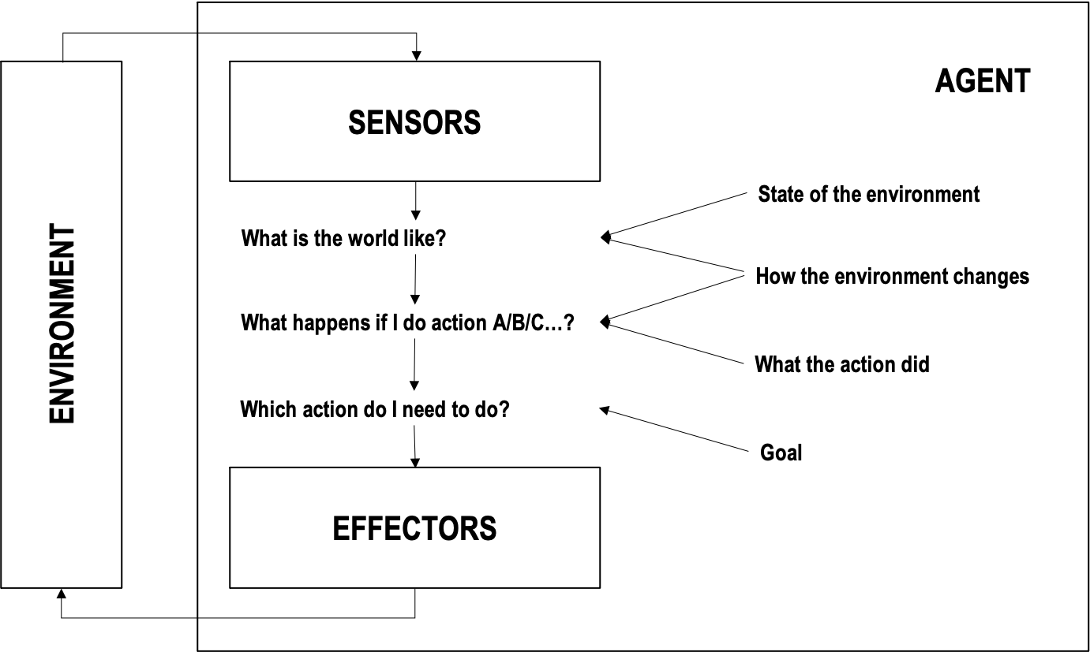
How Does a Rational Agent Work?
A rational agent is essentially a goal-based agent.
It assesses its environment by considering what it is like.
It then looks at each available action in its arsenal and determines how it will affect the environment and help it attain its goal.
It tries out all the possible steps before choosing the best one, that will move it closest to its objective.

Slide 30
How Does a Rational Agent Work?
A sensor could be a camera, an infrared device, a sonar, an ultrasound, a radar, or a lidar in the image above.
It helps an AI robot determine an object’s or its surroundings, size, identify a thing, and determine distances.
An effector, meanwhile, is any device that affects a particular environment.
It could be a robot’s legs, wheels, arms, fingers, wings, or fins.

Slide 31
Real-World Applications of a Rational Agent
Rational agents are also used in
self-driving vehicles,
energy-saving air-conditioning units,
automated lights,
Autonomous vacuum cleaner, and
other devices that need environmental inputs to decide the best course of action to take

Slide 32
Vacuum Cleaner
A rational agent can be used for an autonomous vacuum cleaner.
When it runs, it always looks at its surroundings to determine where it will go next.
If something is preventing it from moving to the left (e.g., a sofa leg), it will consider moving to the right and do so if it can.
It moves around a room, avoiding obstructions (i.e., furniture) while moving back and forth, sucking dirt when present.
It has the environment as the floor which it is trying to clean.
It has sensors like Camera's or dirt sensors which try to sense the environment.
It has the brushes and the suction pumps as actuators which take action.

Slide 33
What Makes a Rational Agent Effective?
A rational agent works if you can measure its performance.
The higher its performance measure is, the more rational an agent is.
Its performance measure is gauged using these criteria:
How well it achieves its goals
How well it assesses its environment
How many actions it can perform

Slide 34
A self-driving car
A self-driving car, for example, is rational if it can bring you safely and comfortably where you need to go in the shortest amount of time.
It needs to follow road signs and directions and avoid other vehicles, people, and other obstructions, including traffic.
Autonomous vehicles have sensors that include cameras, sonars, Global Positioning System (GPS) devices, speedometers, odometers, accelerometers, and keyboards.
They also have actuators, including steering wheels, accelerators, brakes, signals, and horns.

Slide 35
So, what is a rational agent?
Similar to our brain, which tells parts of your body (e.g., your arms and legs) what to do when your sensors (e.g., eyes, ears, and nose) sense something in your surroundings you need to avoid so you will not get hurt.

Slide 36
PEAS Representation
PEAS is a type of model on which an AI agent works upon.
When we define an AI agent or rational agent, then we can group its properties under PEAS representation model.
It is made up of four words:
P: Performance measure
E: Environment
A: Actuators
S: Sensors

Slide 37
PEAS for self-driving cars
Performance: Safety, time, legal drive, comfort
Environment: Roads, other vehicles, road signs, pedestrian
Actuators: Steering, accelerator, brake, signal, horn
Sensors: Camera, GPS, speedometer, odometer, accelerometer, sonar.

Slide 38
Example of Agents with their PEAS representation
Agent | Performance measure | Environment | Actuators | Sensors
1. Medical Diagnose | Healthy patient Minimized cost | Patient Hospital Staff | Tests Treatments | Keyboard (Entry of symptoms)
2. Vacuum Cleaner | Cleanness Efficiency Battery life Security | Room Table Wood floor Carpet Various obstacles | Wheels Brushes Vacuum Extractor | Camera Dirt detection sensor Cliff sensor Bump Sensor Infrared Wall Sensor
3. Part -picking Robot | Percentage of parts in correct bins. | Conveyor belt with parts, Bins | Jointed Arms Hand | Camera Joint angle sensors.

Slide 39
Types of Agents
Agents can be grouped into five classes based on their degree of perceived intelligence and capability
Simple Reflex Agents
Model Based Reflex Agents
Goal Based Agents
Utility Based Agents
Learning Agents

Slide 40
Simple Reflex agent
The Simple reflex agents are the simplest agents.
These agents take decisions on the basis of the current percepts and ignore the rest of the percept history.
These agents only succeed in the fully observable environment.
The Simple reflex agent does not consider any part of percepts history during their decision and action process.
The Simple reflex agent works on Condition-action rule, which means it maps the current state to action.
Such as a Room Cleaner agent, it works only if there is dirt in the room.

Slide 41
Problems for the simple reflex agent design approach
They have very limited intelligence
They do not have knowledge of non-perceptual parts of the current state
Mostly too big to generate and to store.
Not adaptive to changes in the environment.

Slide 42
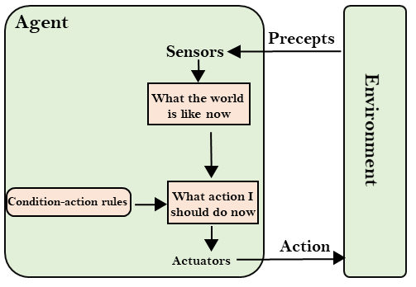

Slide 43
Model-based reflex agent
The agent which performs actions based on current input as well as the previous input
A Simple Reflex agent does not succeed in a partially observable environments. Thus, to overcome its limitations, this agent is designed.
The reason for the success of a this agent is – the agent maintains some sort of internal state.
The internal state depends upon the percept history and thus reflects atleast some of the unobserved aspects of the current state.
In order to maintain the internal state of the world, an agent must,
Know how agent’s own actions affect the world. ( Eg. : If the agent turns the steering clockwise, the car is bound to move towards the right).
Know how the world evolves independent of an agent. ( Eg. : A car trying to overtake will generally close behind the car than it was seconds ago)
This knowledge about “how the world works” is called as the “Model” of the world.

Slide 44
Model-based reflex agent
These agents have the model, "which is knowledge of the world" and based on the model they perform actions.
The Model-based agent can work in a partially observable environment, and track the situation.
A model-based agent has two important factors:
Model: It is knowledge about "how things happen in the world," so it is called a Model-based agent.
Internal State: It is a representation of the current state based on percept history.

Slide 45
Updating the agent state requires information about:
How the world evolves
How the agent's action affects the world.

Slide 46
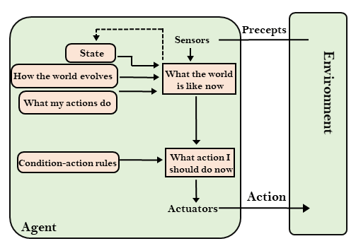

Slide 47
Goal-based agents
The knowledge of the current state environment is not always sufficient to decide for an agent to what to do.
The agent needs to know its goal which describes desirable situations.
Goal-based agents expand the capabilities of the model-based agent by having the "goal" information.
They choose an action, so that they can achieve the goal.
These agents may have to consider a long sequence of possible actions before deciding whether the goal is achieved or not.
Such considerations of different scenario are called searching and planning, which makes an agent proactive.

Slide 48
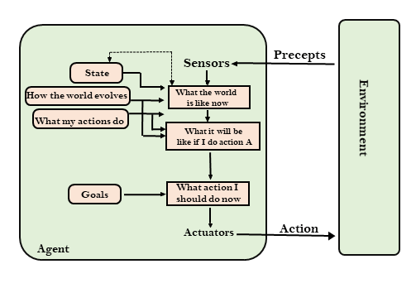

Slide 49
Utility-based agents
These agents are similar to the goal-based agent but provide an extra component of utility measurement which makes them different by providing a measure of success at a given state.
Utility-based agent act based not only goals but also the best way to achieve the goal.
The Utility-based agent is useful when there are multiple possible alternatives, and an agent has to choose in order to perform the best action.
The utility function maps each state to a real number to check how efficiently each action achieves the goals.

Slide 50
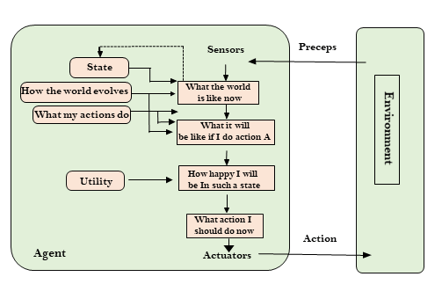

Slide 51
Learning Agents
A learning agent in AI is the type of agent which can learn from its past experiences, or it has learning capabilities.
It starts to act with basic knowledge and then able to act and adapt automatically through learning.
Unlike intelligent agents that act on information provided by a programmer, learning agents are able to perform tasks, analyze performance, and look for new ways to improve on those tasks - all on their own.

Slide 52
Learning agent
A learning agent has mainly four conceptual components, which are:
Learning element: It is responsible for making improvements by learning from environment
Critic: Learning element takes feedback from critic which describes that how well the agent is doing with respect to a fixed performance standard.
Performance element: It is responsible for performance evaluation
Problem generator: This component is responsible for suggesting actions that will lead to new and informative experiences.
Hence, learning agents are able to learn, analyze performance, and look for new ways to improve the performance.

Slide 53
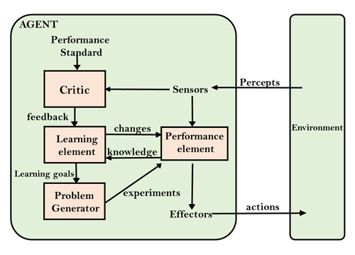

Slide 54
Agent Environment in AI
An environment is everything in the world which surrounds the agent, but it is not a part of an agent itself.
An environment can be described as a situation in which an agent is present.
The environment is where agent lives, operate and provide the agent with something to sense and act upon it.

Slide 55
Features of Environment
As per Russell and Norvig, an environment can have various features from the point of view of an agent:
Fully observable vs Partially Observable
Static vs Dynamic
Discrete vs Continuous
Deterministic vs Stochastic
Single-agent vs Multi-agent
Episodic vs sequential
Known vs Unknown

Slide 56
Fully observable vs Partially Observable
an environment where the agent has complete and accurate information about the current state of the environment at any given time.
Tic-Tac-Toe Game: In the game of Tic-Tac-Toe, the board is a 3x3 grid, and each cell can be empty or occupied by either an "X" or an "O." The agent has complete knowledge of the current state of the board, including the positions of all the X's and O's. The agent can observe the entire board and make decisions accordingly.
the AI agent does not have complete knowledge of the current state of the environment.
Poker Game: In a game of poker, each player holds a set of cards that are hidden from other players. The agent can only see its own cards and the community cards (cards placed on the table), but it cannot directly observe the cards held by other players. The agent has to infer the potential cards held by opponents based on their actions and behaviors.

Slide 57
Deterministic vs Stochastic
If an agent's current state and selected action can completely determine the next state of the environment, then such environment is called a deterministic environment.
A stochastic environment is random in nature and cannot be determined completely by an agent.
In a deterministic, fully observable environment, agent does not need to worry about uncertainty.

Slide 58
Episodic vs Sequential
In an episodic environment, there is a series of one-shot actions, and only the current percept is required for the action.
However, in Sequential environment, an agent requires memory of past actions to determine the next best actions.
In an episodic environment, the agent's experience or interaction is divided into discrete episodes or individual episodes.
The agent's actions and decisions in one episode do not directly impact subsequent episodes.
In a sequential environment, the agent's experience or interaction is continuous and unfolds over time.
The current state and subsequent actions of the agent can be influenced by past actions and observations.

Slide 59
Single-agent vs Multi-agent
If only one agent is involved in an environment, and operating by itself then such an environment is called single agent environment.
However, if multiple agents are operating in an environment, then such an environment is called a multi-agent environment.
The agent design problems in the multi-agent environment are different from single agent environment.

Slide 60
Static vs Dynamic
If the environment can change itself while an agent is deliberating then such environment is called a dynamic environment else it is called a static environment.
Static environments are easy to deal because an agent does not need to continue looking at the world while deciding for an action.
However for dynamic environment, agents need to keep looking at the world at each action.
Taxi driving is an example of a dynamic environment whereas Crossword puzzles are an example of a static environment.

Slide 61
Discrete vs Continuous
If in an environment there are a finite number of percepts and actions that can be performed within it, then such an environment is called a discrete environment else it is called continuous environment.
A chess game comes under discrete environment as there is a finite number of moves that can be performed.
A self-driving car is an example of a continuous environment.

Slide 62
Known vs Unknown
Known and unknown are not actually a feature of an environment, but it is an agent's state of knowledge to perform an action.
In a known environment, the results for all actions are known to the agent.
While in unknown environment, agent needs to learn how it works in order to perform an action.

